Slide 1
Computer Algebra- and Dynamic Geometry Systems in Mathematics Education (CADGME) Conferences from the beginning to the present and future, goals, topics
Csaba Sárvári, University of Pécs
We have established -together with Zsolt Lavicza- four main goals for our CADGME conference:
to separate and develop valuable research initiatives during exhaustive discussions with colleagues;
to think collectively about further research directions for enabling us to use CAS-DGS more effectively both in mathematics and mathematics teaching;
to strengthen cooperation in the CAS-DGS research and teaching community;
we wanted and want to help the younger colleagues' scientific career.

Slide 2
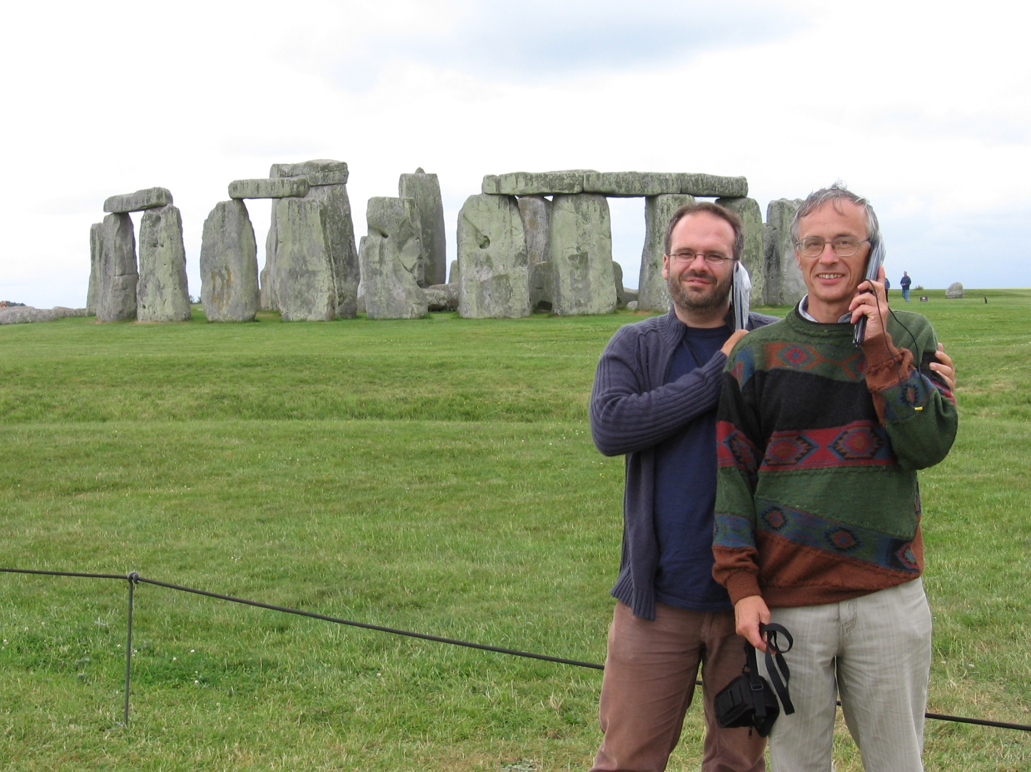

Slide 3
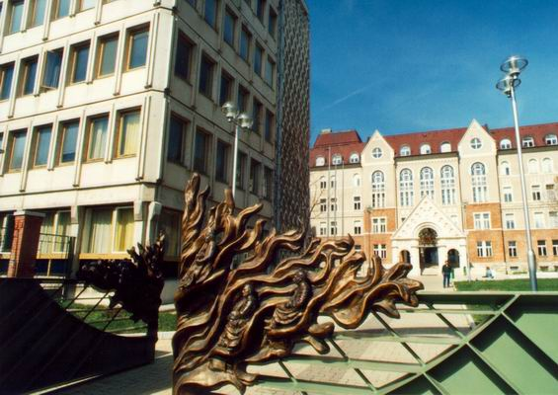
First Central- and Eastern European Conference on
Computer Algebra- and Dynamic Geometry Systems in Mathematics Education (CADGME) University of Pécs, Pollack Mihály Faculty of Engineering, Hungary
21-23 June, 2007
Keynote speakers:
Kenneth Ruthven, University of Cambridge, UK Herschel’s heritage and today’s technology integration: a postulated parallel
Colette Laborde, Université Joseph Fourier, France The design of tasks taking full advantage of dynamic geometry: what kinds of knowledge does it require from teachers?
Bruno Buchberger, RISC - University of Linz, Austria Lazy Thinking: A reasoning strategy for inventing algorithms Edith Schneider, University of Klagenfurt, Austria
CAS as didactical challenge Luc Trouche, Université Montpellier, France Resources for teaching mathematics in ICT environments: which, who and how? Vlasta Kokol-Voljc, University of Maribor, Slovenia Assessment in CAS and DGS environment
https://cadgme2007.mik.pte.hu/

Slide 4
CADGME 2007. Characteristic feature : using CAS or DGS stand alone
Some characteristic talks and workshops Wolfgang Windsteiger
Towards computer-supported proving in maths education Emiliya Velikova and Valentina Voinohovska
Computer-aided scientific research of students for creating original mathematical problems Mehmet Bulut, Yilmaz Aksoy, and Beref Mirasyedioglu
The effects of CAS in the development of problem solving abilities Peter Lebmeir and Jürgen Richter-Gebert
Recognizing the type of a locus with scriptable dynamic geometry software Yip-Cheung Chan
Different approaches of interplay between experimentation and theoretical consideration in dynamic geometry exploration: An example from exploring Simon line Zoltan Kovacs
Blind Versus Wise Use of CAS
Ulrich Kortenkamp
Beyond DGS - Simulations and Scripting with Cinderella Markus Hohenwarter
GeoGebra in Secondary School Teaching
Colette Laborde
Connecting geometrical, numerical and algebraic aspects of 3D geometry using Cabri3D

Slide 5
Zoltan Kovacs Blind Versus Wise Use of CAS
„During my courses for mathematics major students I often use technology linked to the arising problems. In such cases I noted that some students were used to learn just some procedures, which made them able to solve (partially) some problems and when they got the result, they accepted it passively and did not relate it to the initial problem.”
My operational philosophy can be articulated as follows:
• You must doubt. Check your result.
• Before pushing the Enter, have an idea concerning the result. Always compare the output with your conception.
• Explain the result: compare with your knowledge, do a simple case by hand.
• Change the parameters (if it is possible), CAS needs your help: you work together with CAS.
• Sometimes the life is easier without CAS. Do not use it when it is not necessary.
• Do not neglect paper and pencil skills.

Slide 6
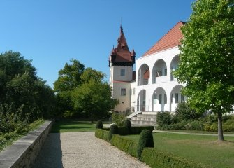
Second Central- and Eastern European Conference on Computer Algebra- and Dynamic Geometry Systems in Mathematics Education (CADGME-2009)
CADGME-2, 11-13, July, GeoGebra 14-15, July, 2009,
RISC, Linz (Castle of Hagenberg), Austria
Keynote speakers:
Paul Andrews (University of Cambridge, UK) Understanding the cultural dimension in research in mathematics teaching
and learning Ralph-Johan Back, Abo Akademi University Turku, Finland Structured Derivations: A Method for Teaching Proofs in High School Mathematics
Bruno Buchberger (RISC, University of Linz, Austria) Mathematical Invention: How Much Can be Automated?
André Heck (University of Amsterdam, Netherlands) Modelling in Cross-Disciplinary Authentic Student Research Projects
Jozef Hvorecký (City University Bellevue, Bratislava, Slovakia) Using a Managerial Analogy for Making Mathematics More Attractive
http://www.risc.jku.at/conferences/cadgme2009/?content=general

Slide 7
CADGME - 2009. Characteristic features, topics:
integration of CAS and DGS appears the topic Teorem Proving thinking about past, present and future
Some characteristic talks Jesus Escribano, Francisco Botana, Miguel Abanades
Integrating DG and CAS abilities under a common framework Steve Arnold
Dynamic integration of CAS and DGS: what does this mean? Walther Neuper
Common grounds for modeling mathematics in educational software Markus Hohenwarter
GeoGebra - Past, present, and future of this Dynamic Mathematics Software Pedrag Janicic
Automated geometry theorem proving: readability vs. efficiency

Slide 8
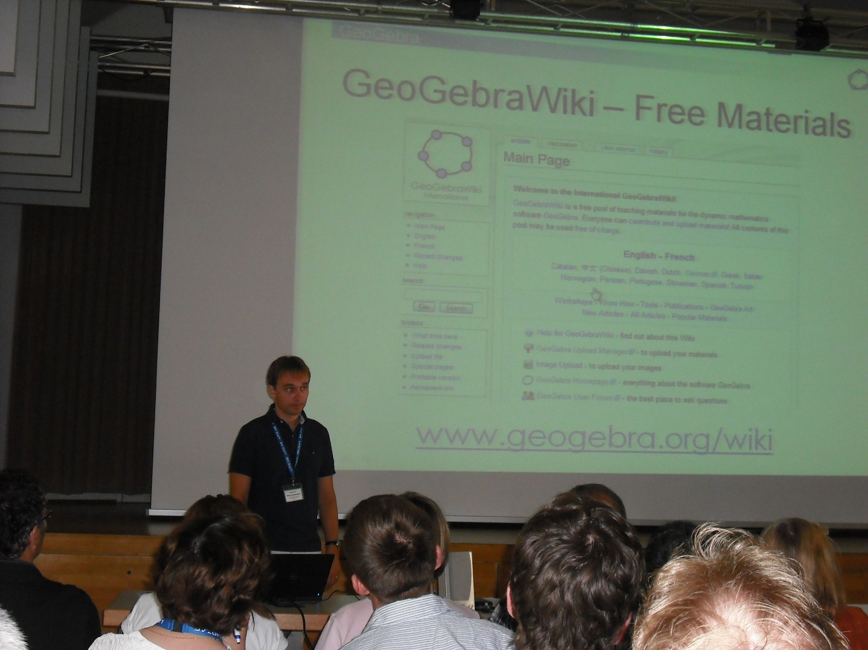

Slide 9
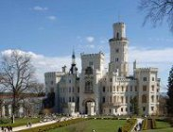
Third Central- and Eastern European Conference on
Computer Algebra- and Dynamic Geometry Systems
in Mathematics Education
29 June -1 July, 2010 Hluboká nad Vltavou, Czech Republic
Keynote speakers:
Paul Drijvers, Netherlands The teacher and the tool
Ulrich Kortenkamp , Germany Interoperable Interactive Geometry for Europe
Matija Lokar, Slovenia Using learning blocks to prepare e-content for teaching mathematics
Pavel Pech, Czech Republic Classical vs. Computer Approach in Proving Theorems
Francisco Botana, Spain On using automated deduction techniques in dynamic geometry environments
Wei-Chi Yang, USA
Why should we integrate Computer Algebra System with Interactive Geometry?
http://home.pf.jcu.cz/~cadgme2010/

Slide 10
Opening of the CADGME 2010 Conference

Slide 11
CADGME – 2010. Characteristic features, topics: special learning modes with different special tools, special modes of proof, automated theorem proving, creation new tools
Some characteristic talks Philippe R. Richard, Leduc Nicolas, Tessier-Baillargeon Michele and Gagnon Michel Contribution of a computer algebra system (CAS) in the solving of problems in geometry with the help of an emerging tutorial system Andreas Fest, Maren Hiob-Viertler and Andrea Hoffkamp. An interactive learning activity for the formation of the concept of function based on representational transfer Gabriel Katz and Vladimir Nodelman Computer-aided Explorations of Two-Parameter Modular Spaces: Giving Geometric Life to Routine Algebra. Paul Drijvers Instrumental orchestrations of mathematical situations in technological environments: deepening the concept through concrete examples Matija Lokar, Primož Lukšič Flexible mathematics content preparation

Slide 12
Keynote speakers: Alan Rogerson (International Consultant in Maths Education, Poland) Fundamentals, the Future and the Power of the Force Adrian Oldknow (Emeritus Professor, University of Chichester, UK) Software and activities to motivate and support learners in mathematics, science and technology Jean-baptiste Lagrange (University of Reims, France) Functions, Dynamic Geometry and CAS: offering possibilities for learners and teachers Hans-Georg Weigand (University of Würzburg, Germany) Theses about the use of computer algebra systems in the next decade Olga Hadžić (University of Novi Sad, Serbia) The Role of Computers in Changing Students Attitudes Towards Mathematics
http://www.dmi.uns.ac.rs/cadgme2012/index.html

Slide 13
CADGME 2012. Characteristic features, topics: discussing the potential of Theorem-Prover based Systems (TPS) for educational practice. (eduTPS) different aspects of using GeoGebra and other DGS
Some characteristic talks Jan Rocnik and Walther Neuper
Interactive Course Material by TP-based Programming. A Case Study Lajos Szilassi
The possibilities of and limits to the application of the GeoGebra dynamic geometry programme in elementary and secondary education Francesca Ferrara and Ornella Robutti
The use of DGS to face optimization problems at secondary school Ulrich Kortenkamp, Christian Dohrmann and Paul Libbrecht Open Discovery Space: Sustaining the Intergeo Project for DGS content and teachers' CPD in Europe

Slide 14
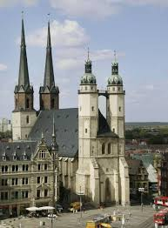
Fifth Central- and Eastern European Conference on Computer Algebra- and Dynamic Geometry Systems in Mathematics Education 26-29 September, 2014 Halle (Saale), Germany
Keynote speakers:
Ralph-Johan Back, Abo Akademi University Turku, Finland Structured derivations in practice: experiences from the E-math project
Marcelo de Carvalho Borba, Graduate Program in Mathematics Education, UNESP/Brasil Math Problem, Facebook and Emergent Classrooms Predrag Janičić, University of Belgrade, Serbia Challenges for the Next Generation Mathematics Education Software
Tomás Recio, Universidad de Cantabria, Santander, Spain Dynamic Geometry and Mathematics: few trains on a two-way track
Jürgen Richter-Gebert, University of Technology, Munich, Germany
Mathematics on electronic media in a changing world
http://cadgme2014.cermat.org/

Slide 15
CADGME - 2014. Characteristic features, topics: How resources are transforming the practice? Challenges for the Next Generation Mathematics Education Software
Some characteristic talks Theodosia Prodromou, Zsolt Lavicza, Balazs Koren
Increasing students’ involvement in technology-supported mathematics lesson sequences
Paul Libbrecht
Adaptations to a Learning Resource Světlana Tomiczková and Miroslav Lávička
Using dynamic geometry and computer algebra systems in problem based courses for future engineers Lilla Korenova Mobile learning in elementary and secondary school mathematics in Slovakia
Florian Schacht Student Documentations in Mathematics Classrooms Using Digital Tools: Theoretical Considerations and Empirical Findings

Slide 16
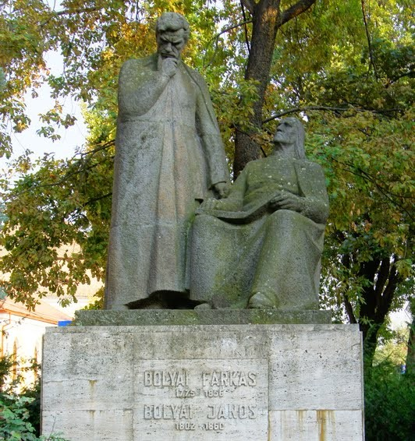
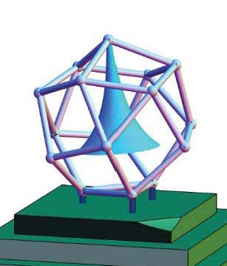
Sixth Central- and Eastern European Conference on Computer Algebra- and Dynamic Geometry Systems in Mathematics Education
7-10 September, 2016 Targu Mures, Romania
https://cadgme.ms.sapientia.ro/index.html
Keynote speakers:
Christian Bokhove , (University of Southampton, UK) Using technology for maths teaching and learning: instructional design, digital books and automated feedback Noah Dana-Picard , (Jerusalem College of Technology, Israel) The usage of technology to revive classical topics in mathematics Zoltán Kátai, (Sapientia University, Targu Mures, Romania) Learning algorithms in technologically and artistically enhanced interactive environments Zsolt Lavicza, (STEM Education Centre, Johennes Kepler University, Linz, Austria) GEOMATECH: Integrating Technology into Primary and Secondary School Teaching to Enhance Mathematics Education in Hungary Morten Misfeldt, (Aalborg University, Copenhagen, Denmark) Teaching mathematics with reasoning tools: learning, teaching and curriculum planning

Slide 17
CADGME - 2016. Characteristic features, topics: The impact of digital tools on students' learning of geometry; Modeling and Experimental Approach in Math Classrooms
Some characteristic talks Kristóf Fenyvesi, Zsolt Lavicza, Diego Lieban, Imre Nyögéri, Ho-gul Park & Taeyoung Choi STEAM Workshops for Collaborative Problem Solving Based on Connecting Hands-on 4dframe Activities with the Implementation of Geogebra Valentyna Pikalova Teaching and Learning Math Behind Computer Science with the Help of GeoGebra and Python Zoltán Kovács and Csilla Sólyom-Gecse GeoGebra Tools with Proof Capabilities Miguel A. Abanades, Francisco Botana, Zoltan Kovacs, Tomas Recio and Csilla Solyom-Gecse Automatic Discovery in GeoGebra: First Steps Gregor Jerše and Matija Lokar Learning and teaching programming and numerical methods with a system for automatic assessment

Slide 18
The thematic expansion of CADGME conferences
1. The aim of the conference is to establish a forum for academics in Central- and Eastern Europe to be able to share their work with regard to CAS and DGS.
2. Theorem-Prover based Systems for Education (eduTPS)” played an important role at CADGME ’12, the conference on Computer Algebra and Dynamic Geometry Systems in Mathematics Education held at Novi Sad in June 2012.
3. One of the working groups of CADGME 2018 will be TAME: Technology, Arts and Mathematics Education One of the keynotes: STEAM-ing Up Learning with GeoGebra: from Explorations in Arts and Design to Robot-making Activities
Notes:
STEAM is an educational approach to learning that uses Science, Technology, Engineering, the Arts and Mathematics as access points for guiding student inquiry, dialogue, and critical thinking. The end results are students who take thoughtful risks, engage in experiential learning, persist in problem-solving, embrace collaboration, and work through the creative process. These are the innovators, educators, leaders, and learners of the 21st century!

Slide 19
Publications of reviewed papers presented at CADGME
We published papers about talks at the CADGME conferences in the following peer-reviewed journals:
Teaching Mathematics and Computer Science (TMCS)
The International Journal for Technology in Mathematics Education (IJTME)
The Electronic Journal of Mathematics & Technology (eJMT) and
Acta Didactica Napocensia (ADN) We published more than 140 papers the majority of them in Special Issues.

Slide 20
Seventh CADGME - Conference on ﻿Computer Algebra and Dynamic Geometry Systems in Mathematics Education﻿ 26-29 June 2018 University of Coimbra, Portugal
Jaime Carvalho e Silva, University of Coimbra, Portugal The challenges schools face with the development of Computer Algebra Kristof Fenyvesi, University of Jyväskylä, Finland STEAM-ing Up Learning with GeoGebra: from Explorations in Arts and Design to Robot-making Activities Phillipe R. Richard, University of Montréal, Canada The Utility of the Automatic Reasoning Tools for Performing Mathematical Work Ornella Robutti, University of Torino, Italy Mathematics teachers working in collaboration with the use of technology ﻿Katarzyna Winkowska-Novak, SWPS University, Poland ﻿GeoGebra role in building mental models and improving computational thinking skills
https://www.uc.pt/en/congressos/cadgme2018

Slide 21
CADGME - 2018. Thematic expansion, characteristic features, topics:
Organizing of learning environment
Technical tools
Program languages, Computer programs
Blended learning
Tablet, Tablet-app
Automated reasoning tools
Meta-Didactical Transposition
MOODLE Learning Management System
Proof with the support of DGS
Peer review metodology
Flipped classroom

Slide 22
CADGME 2018
Some characteristic talks/papers
Umberto Dello Iacono, Anna Pierri and Eugenia Taranto Peer review methodology in a blended course for mathematics teacher education
Ana Donevska -Todorova
Towards a model for tablet app-enriched learning environments for mathematics education
Jiří Blažek and Pavel Pech Synthetic proof with the support of dynamic geometry
Tomas Recio, Philippe R. Richard and M. Pilar Velez Designing tasks supported by GeoGebra Automated Reasoning Tools for the development of mathematical skills
Zsolt Lavicza, Theodosia Prodromou, Kristof Fenyvesi, Markus Hohenwarter, Istvan Juhos, Balazs Koren
Integrating STEM-related technologies into mathematics education at a large scale

Slide 23
STEAM and CADGME
Technology and Arts in Mathematics Education - workgroup
Daniela Ferrarello, Maria Flavia Mammana and Eugenia Taranto, Non-Euclidean Geometry with art by means of GeoGebra
Eleonora Stettner, Traditional Patterns of Easter Eggs in the Carpathian Basin ands pherical Symmetries (Illustrating Spherical Symmetries in GeoGebra)
Zsolt Lavicza, Kristóf Fenyvesi, Philip Collett, Thierry Dana-Picard, Sara Hershkowitz, Werner Olivier, Gyorgy Tury, Gabriella Uhl and Diego Lieban, STEAM for the Future - Integrating Hungarian, Israeli and South African Arts into Mathematics Teaching
Daniel Lakos and Eszter Losonczi, Jump from paper
Tomás Recio, Exploring artwork through Voronoi/Delaunay diagrams
Alla Stolyarevska, DeepDream reveals the connection between art and mathematics

Slide 24
Traditional Patterns of Easter Eggs in the Carpathian Basin and Spherical Symmetries (Illustrating Spherical Symmetries in GeoGebra)
Eleonóra Stettner
Kaposvár University
Rózsa Nienhaus
Egg Art Museum Zengővárkony
CADGME - Conference on Digital Tools in Mathematics Education﻿
25-29 June 2018
University of Coimbra, Portugal

Slide 25
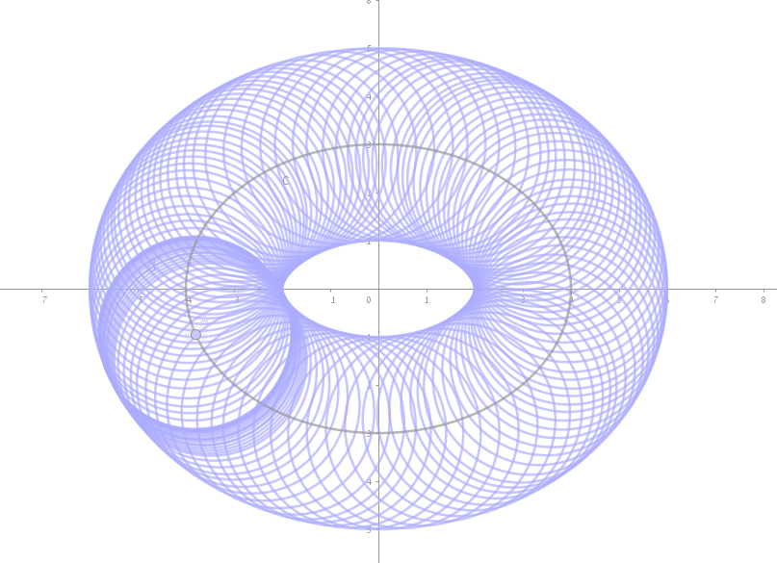
We are honored to invite you to attend the 8th International Conference on Computer Algebra- and Dynamical Geometry Systems in Mathematics Education CADGME 2020 on the campus of the Jerusalem College of Technology, Israel
June 21-25, 2020
Organizing committee:
Thierry (Noah) Dana-Picard, JCT, IL
Sara Hershkovitz, CET, IL
Zsolt Lavicza, JKU, AT
Csaba Sárvári, Pécs U., HU
Roi Shilo, CET, IL
Yaacov Koletker, JCT, IL
The website will be aired within a few days.
Info: cadgme2020 (at) jct.ac.il

